Slide 1
Ambulance Service
PIP104 University Project-II
Review-2
Batch Number: CSE-G 186
Roll Number | Student Name
20201CSE0710 | MAHESH
20201CSE0689 | PRASHANTH S H
20201CSE0681 | AKSHAY M
20201CSE0677 | H DILEEP
Under the Supervision of,
Mr. PRAKASH B METRE
Assistant Professor
School Of Computer Science and Engineering
Presidency University

Slide 2
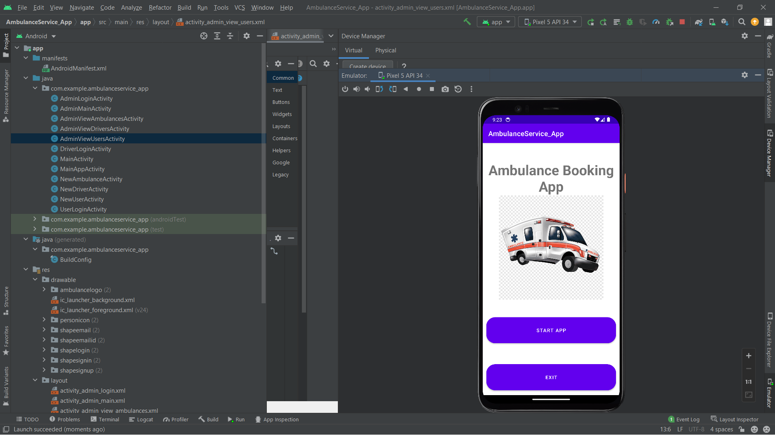

Slide 3
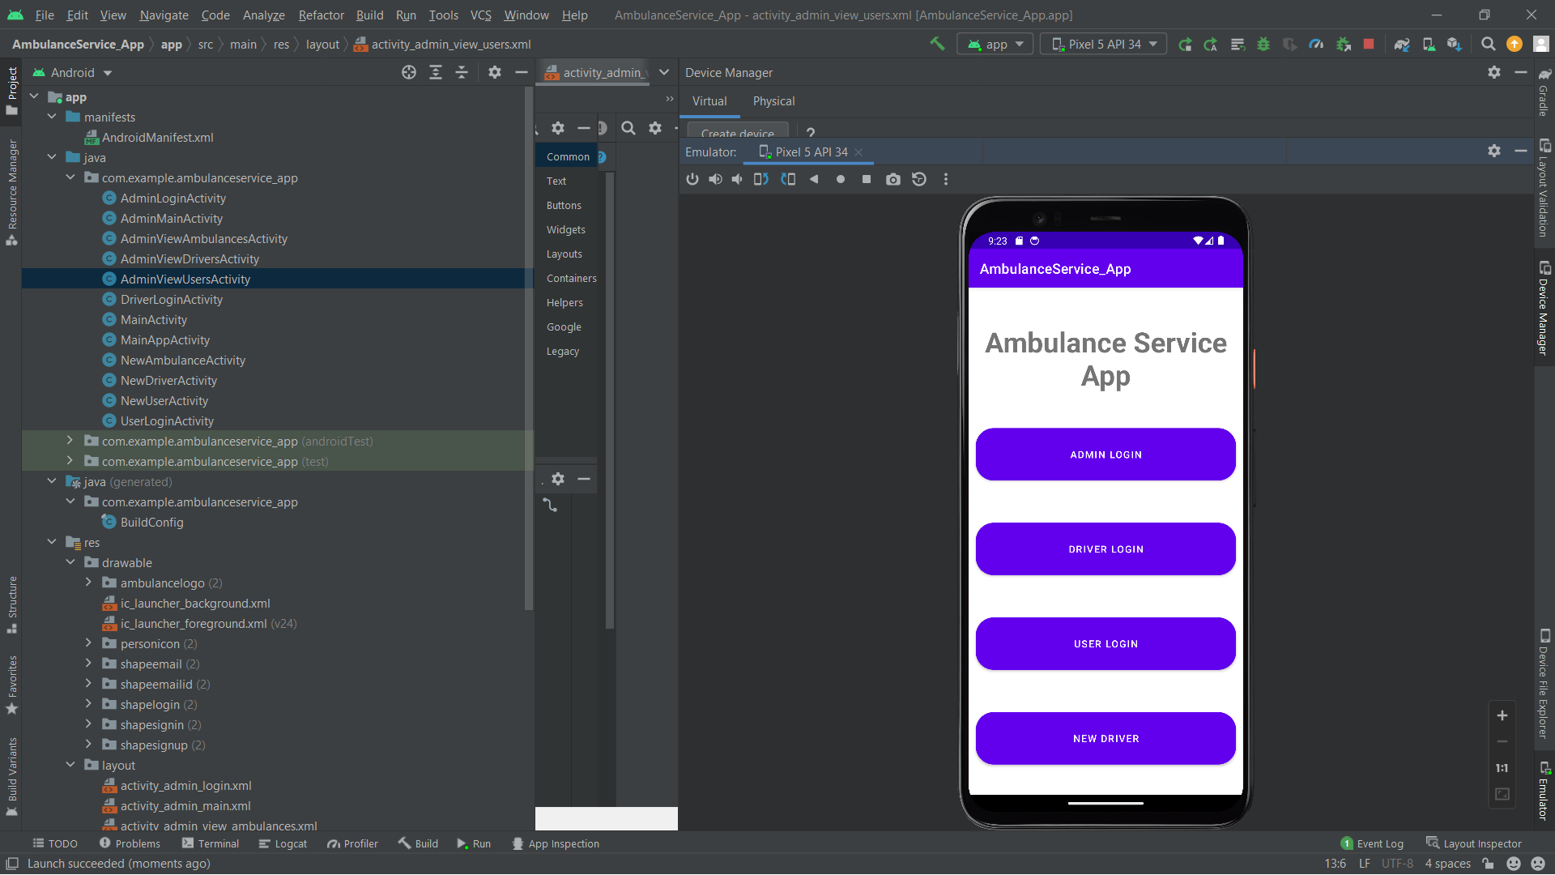

Slide 4
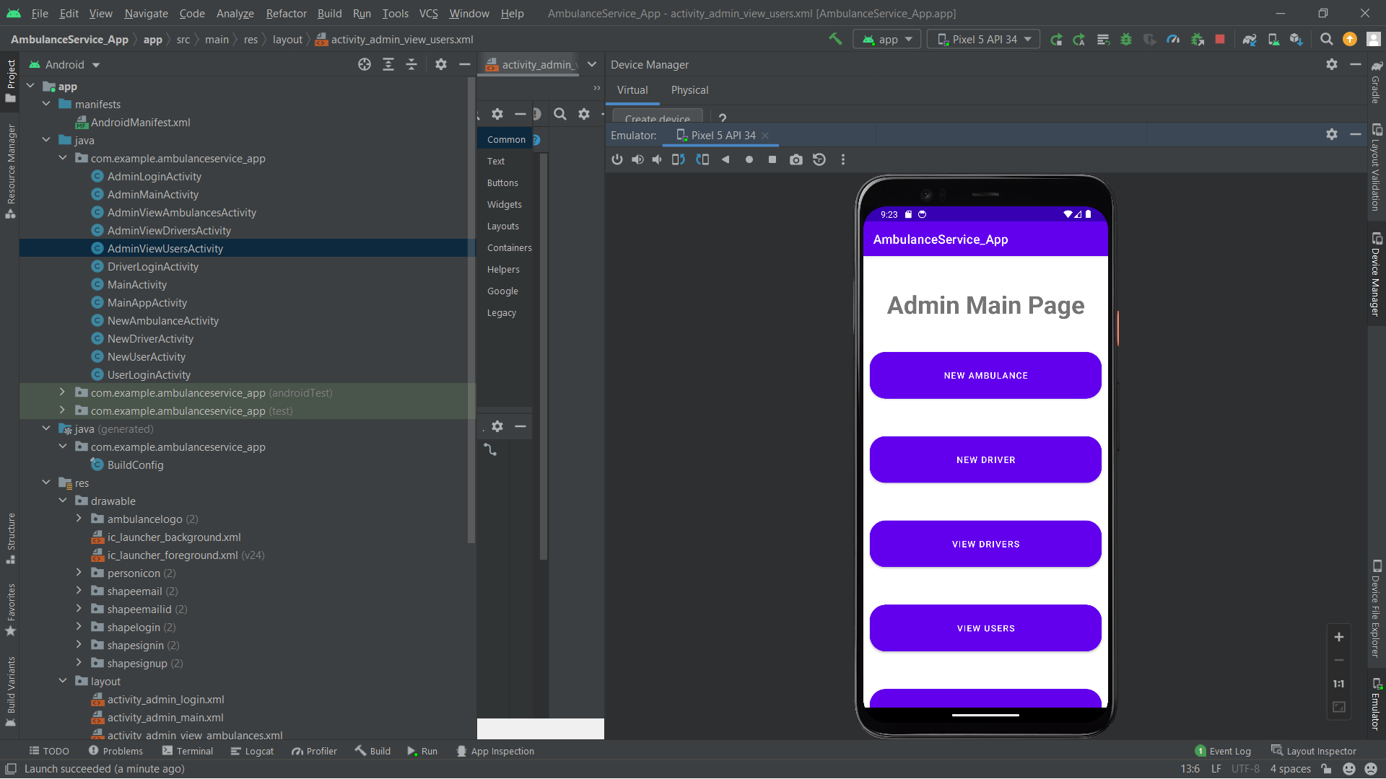

Slide 5
Source Code
class MainAppActivity extends AppCompatActivity {
Button adminLoginBtn, driverLoginBtn, userLoginBtn, newUserBtn, newDriverBtn, gobackbtn;
function onCreate(savedInstanceState: Bundle) {
super.onCreate(savedInstanceState);
setContentView(R.layout.activity_main_app);
adminLoginBtn = findViewById(R.id.adminsignin);
driverLoginBtn = findViewById(R.id.driversignin);
userLoginBtn = findViewById(R.id.usersignin);
newDriverBtn = findViewById(R.id.newdriverbtn);
newUserBtn = findViewById(R.id.newuserbtn);
gobackbtn = findViewById(R.id.gobackbtn);
newUserBtn.setOnClickListener(new OnClickListener() {
function onClick(v: View) {
navigateTo(NewUserActivity.class);
}
});
adminLoginBtn.setOnClickListener(new OnClickListener() {
function onClick(v: View) {
navigateTo(AdminLoginActivity.class);
}
});
userLoginBtn.setOnClickListener(new OnClickListener() {
function onClick(v: View) {
navigateTo(UserLoginActivity.class);
}
});

Slide 6
Source Code
driverLoginBtn.setOnClickListener(new OnClickListener() {
function onClick(v: View) {
navigateTo(DriverLoginActivity.class);
}
});
newUserBtn.setOnClickListener(new OnClickListener() {
function onClick(v: View) {
navigateTo(NewUserActivity.class);
}
});
newDriverBtn.setOnClickListener(new OnClickListener() {
function onClick(v: View) {
navigateTo(NewDriverActivity.class);
}
});
gobackbtn.setOnClickListener(new OnClickListener() {
function onClick(v: View) {
navigateTo(MainActivity.class);
}
});
}
function navigateTo(destinationClass: Class) {
Intent intent = new Intent(getApplicationContext(), destinationClass);
startActivity(intent);
}
}

Slide 7
Conclusion
Our conclusion is we have developed our project and if it work as we have expected then it will be very successful application which will be useful in our day to day life. And according with smart city project we will be able to go one step forward in health sector also. In this paper, an idea is developed for saving a patient's life in a faster way as possible. It is very important for users in case of emergencies as it saves time. With this Application, the ambulance can reach to the user or patient as location is tracked or given through the application and also can provide necessary equipment’s which is required for the patient's health.

Slide 8
Thank You

